Slide 1

Capability Overview
Reduce time to market and increase product quality through test optimisation and flexible delivery!

Slide 2
Introductions

Slide 3
Background
Woodside Energy are looking for an independent expert assessment of Woodside Energy’s current test efforts with a particular emphasis on efficiency, industry best practice and developing a Testing Centre of Excellence.
Planit believe that the best way forward would be to conduct a TPO (Test Process Optimisation) and review, which will assess, Woodside Energy’s Test processes, people and procedures through a recognised framework and plot Woodside Energy against the Test Maturity Model.

Slide 4
Purpose & Agenda
To provide context to who Planit are, why a TPO will provide the essential findings and roadmap that will help Woodside on their journey to a Testing Centre of Excellence.
Session 1 Tuesday 7th March
Session 2 Wednesday 8th March
Company
Overview
20 mins
TPO Overview
20 mins
TCoE Overview
20 mins
Discovery Workshop
90 mins
Question & Answer
30 mins
Next Steps & Close
30 mins

Slide 5
Session 1
- Tuesday 7th March 10am – 12:30pm
- Woodside Energy Offices
- Planit Representatives – Andrew White (Perth Director), Alex Edwards (Enterprise Director Technical Services), Jason Stannage (Perth Principal Consultant) & Phil Johnson (Perth Senior Technical Consultant)
10am
12:30pm
Session 1
Company
Overview
20 mins
TPO Overview
20 mins
TCoE Overview
20 mins
Discovery Workshop
90 mins
Who we are
What we Do
Who we work with
Benefits
What it is
Why we do it
Requirements
Outcomes
Why should we do
What’s involved
Who responsible
Benefits
Current issues
Woodside Aspirations
Scoping of TPO
TPO Roadmap to ROI
TPO Prerequisites
Tools discussion
TPO schedule

Slide 6
Session 2
- Wednesday 8th March 9am – 12:00pm
- Woodside Energy Offices
- Planit Representatives – Andrew White (Perth Director), Alex Edwards (Enterprise Director Technical Services), Jason Stannage (Perth Principal Consultant) & Phil Johnson (Perth Senior Technical Consultant)
9am
10:00pm
Session 2
Question & Answer
30 mins
Day in the life of
High level issues
Where do you want to go
Open Forum
Feedback
Next Course of action
AOB
Next Steps & Close
30 mins

Slide 7
Company Overview
Who we are
Market Position
Service Capabilities
Case Study

Slide 8
Who We Are
Our Organisation
Structure
History
Services

Slide 9

1200+ Full Time Employees
Our Organisation

Slide 10

One of the Top 4 Pure Play Testing Companies Across the Globe
AUCKLAND BRISBANE CAMBRIDGE CHRISTCHURCH HAMILTON MELBOURNE HYDERABAD MUMBAI PERTH READING SYDNEY WELLINGTON
* Source: Technavio - GLOBAL PURE PLAY SOFTWARE TESTING SERVICES MARKET 2015-2019

Slide 11
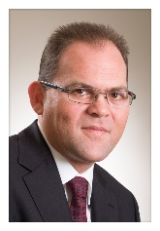




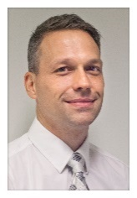



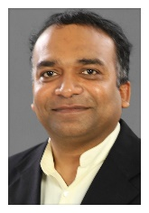



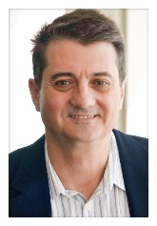
Structure
Chris Carter
Managing Director
Mike Weale
COO
Winnie Gu
Director of Finance
Emma Pilcher
Human Resource Manager
Directors of Testing Services
Graham Davis
Sydney
Darren Dalla Riva
Melbourne
Dan Minkin Auckland
Mike Tate Wellington
Simon Farrant United Kingdom
Paresh Shrivastava
India
Alex Edwards Director of Technical Testing Services
Andrew White
Director of Operations - Perth
Andrew Simister Director of Test Factory
James Pennefather Director of Training

Slide 12
History
Over 750 permanent staff
The Growth Fund Partners with Planit
Focus Quality Awards Winner
Planit opens offices in Brisbane, Christchurch and Hamilton
Tech Testing department Established & HP Best New Partner Award
BRW Fast 100
Planit commence operations in Australia
Wellington Office opened
BRW Momentum Finalist
1998
2006
2008
2010
2012
2014
2016
1997
2007
2009
2011
2013
2015
Over 100 permanent staff
UK Office opened & 600 permanent staff
Planit establishes partnership in India & Auckland Office opens
Over 500 permanent staff & Perth Office opened
Planit reaches 1000+ permanent staff
iAwards Finalist NZ CIO Awards Finalist for Youth in ICT
Planit acquires TenX Labs India
Planit opens its Melbourne Office
HR Awards Finalist & Telstra Business Awards Finalist

Slide 13
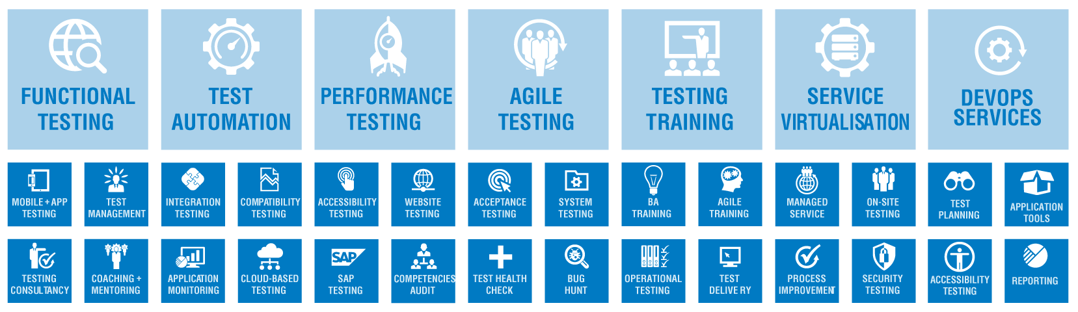
Services

Slide 14
Market Position
Market Drivers
Value Proposition
Partner Strategy
Our Clients
Benefit Realisation

Slide 15
Market Drivers
General Drivers:
Global Software Test Market growing 11% per annum
Core Application Integration / Core Application Maintenance and Legacy Transformation
Bi-Modal Delivery requires parallel testing
New App Development
Faster time to market
Cloud first
Digital and mobility
IoT and IoME
Test Drivers:
Tool Chain
Tighter Integration with Dev – (Dev Centric Test delivery )Agile and DevOps
Outcome based delivery
Pressure on tools vendors for consumption and cloud based delivery
Essentially demand is driven by continued application growth

Slide 16
Value Proposition
Rapid delivery and flexibility across all facets of Testing.
Unique Cloud based offerings with services and tooling.
Providing Quality Outcomes utilising ALL offerings
Producing Testing Efficiencies = Aiming for 10% Year on Year

Slide 17


Partner Strategy
Insight
Tooling
Notes:
Demonstrate our bias where we have capability and capacity

Slide 18

Planit’s Clients
Regional
Australia, New Zealand and UK
Industry Vertical
Accommodation and Foodservice, Agriculture, Banking, Construction, Energy, Entertainment, Government, Insurance, Healthcare, Manufacturing, Mining, Retail, Telecom, Travel and Transportation, Wholesale
Key Clients
BHP, RAC, NBN, CommSec, QANTAS, Sydney Airport, Vodafone, Medibank, WA Gov’t, Federal Gov’t and more

Slide 19

Realise the Benefits
Visibility
Accelerate Delivery
Improve Customer Experience
Increase Product Quality
Optimise App Performance
Continuous Improvement

Slide 20



Scalable
On-Demand
Flexible

Slide 21
Service Capabilities
Engagement
Delivery
Methodologies
Functional Testing
Test Automation
Performance
Service Virtualisation
Cloud
Training
Innovation

Slide 22





Engagements
Time & Material
Outcome Based
Fixed Price
Managed Services
Blended

Slide 23





Delivery
On Shore
Near Shore
Off Shore
Hybrid
Crowd

Slide 24




Methodologies
Agile
Traditional
Hybrid
Planit

Slide 25




Continuous Integration
Integration Daily
Solve Problems Quickly
Automate Build
Automate Deployment

Slide 26

DevOps

Slide 27









Functional Testing
Component
Testing
User Acceptance
Testing
System
Testing
Regression
Testing
Integration
Testing
Strategy
Process Improvement
Execution
Design

Slide 28





Test Automation
Understanding Goals
Tool Selection & POC
ROI Calculation
Framework & Implementation
Maturity & Improvement

Slide 29




Performance Testing
Risk Assessment & Planning
Performance Tool Advice & Provision
Performance Test Execution
Performance Monitoring & Reporting

Slide 30




Service Virtualisation
Remove Bottlenecks from Test Environments
Reduce 3rd Party Platform Reliance
Shift Left: Start Testing Sooner
Gain Full Control of Your Test Data

Slide 31




TMaaS
Global Access
Best Practice Workflow
Traditional & Agile Supported
Level 1-3 Support & Training

Slide 32

Cloud Offerings
TMaaS
PERFaaS
SVaaS
APMaaS

Slide 33





Training
Experience Expert Trainers
Practical Learning Outcomes
Industry Leading Pass Rates
Accredited Courses

Slide 34




Innovation
Internet of Things
DevOps
Cloud Tool Chain
Self Service
Portal

Slide 35
Case Study
Client Drivers
Client Scope
Client Outcome

Slide 36

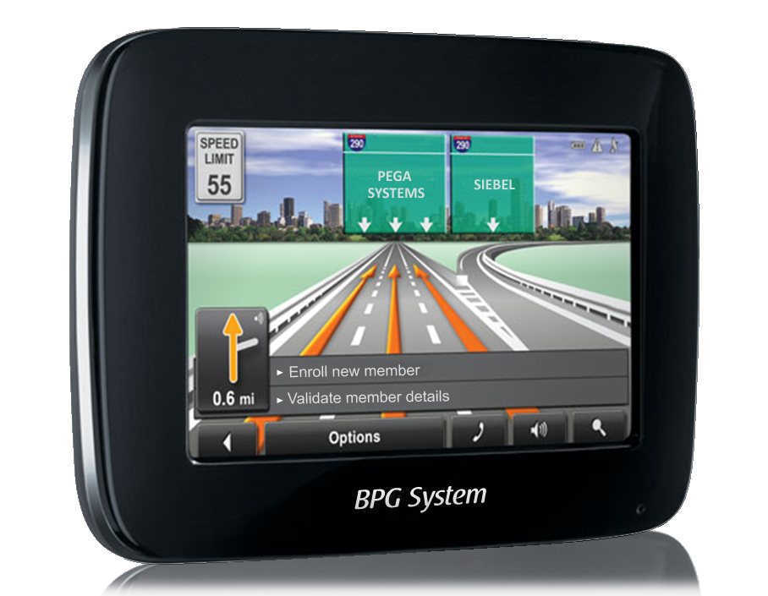
Panviva’s Drivers
Case Study
Major transformation & testing partnership | Gartner Cool Vendor Award
Increasingly complex business processes and systems
long time to competence, more complicated products to deal with
Increasing focus on costs
cost management challenges in scale, efficiency, ROI
Constant change
Systems, processes, products
customer expectations
must ensure process consistency and accuracy
High compliance requirements
serious consequences of process error
training can’t keep pace with the changes
‘going by memory’ guarantees error
Context sensitive real-time guidance
Relevant to your point in process
Simplify complexity, compliance
Reduce training, errors, escalations

Slide 37
Where Panviva needed to be and quickly
Partner Selection Criteria
Stable and less cumbersome codebase
Extensible: for what we know now, more so what we don’t know yet
All users globally are on same codebase, patch level
Rapid development, rapid go to market
Quick take-up, rapid integrations, multi-device
Agnostic of end-user IT variations, consistent user experience
Understood our vision, able to consult realities of journey
Local skilled resources
Able to work as part of our team
Cost effective
Flexible engagement model

Slide 38
Panviva Outcomes
Managed service
10 fold increase in coverage
81% Reduction in time to test
50% Efficiency gains
Increase in release cycles
Faster time to market
Strengthened quality position with our clients
Reduced reliance on perm and specialist staff

Slide 39

Test Process Optimisation Overview

Slide 40


Overview
An independent audit of current testing practices both documented and being used and consider this against current testing best practices. Provides gap analysis between the as is to the target state ( Testing Centre of Excellence)
Scalable
Repeatable
Reliable
Auditable
Efficient

Slide 41
Test Process Optimisation (TPO)
Asses Maturity of Test
Deliverables
Interview findings across key areas
Current test maturity, target test maturity
Roadmap on how to achieve target state
Best Practice recommendations
Report with detailed findings
Next steps
Identify Future State
Roadmap to achieve future state
High Level Estimates and resources
Review Test Assets
Best Practice review

Slide 42
TPO Approach
Initiation
Agree on scope and identify relevant stakeholders
Stakeholder interviews
On site engagement, interviewing all relevant stakeholders
Artefacts review
Conclusions & Recommendations
Documented report
Follow up
Reviewing all relevant testing artefacts
Agree on and initiate recommended actions
Using standardised questionnaire, utilizing ISTQB standards & Planit’s consulting experience
Reviewing SDLC processes & Test integration
Presentation of the findings and recommendations to all stakeholders
Prepare and distribute relevant documents
Plan interviews
Define a Maturity Roadmap

Slide 43
Stakeholder interviews
Quality Assurance
Infrastructure
“All relevant stakeholders are interviewed to gain a holistic perspective of the current state.”
Project Management
Subject
Matter Expert
Test Governance
Development
Business
As Usual
Vendors
Budget Holder

Slide 44
Artefact Review
Management & Control
Test Preparation
“Key areas are reviewed using an extensive and standardised checklist.
Testing and related artefacts are assessed.
Evaluation is performed against defined criteria and maturity levels, according to industry standards, such as ISTQB and CMMi.“
Estimation & Planning
Test Execution
& Defect Management
Test Governance
Roles & Resources
Configuration & Release Management
SDLC Integration
Environment & Test Data

Slide 45
Assessment Areas
Area
L | Life cycle of the testing process relative to the SDLC
O | Organisational structure
I | Appropriate Infrastructure and relevant tools
T | Practical and suitable techniques
# | Extent | Assessment Area
1 | L | Key Area 1 – Test Strategy
2 | L | Key Area 2 – Lifecycle Model
3 | L | Key Area 3 – Moment of Involvement
4 | T | Key Area 4 – Estimation and planning
5 | T | Key Area 5 – Test specification techniques
6 | T | Key Area 6 – Static test techniques
7 | T | Key Area 7 – Metrics
8 | I | Key Area 8 – Test automation
9 | I | Key Area 9 – Test environment
10 | I | Key Area 10 – Office environment
11 | O | Key Area 11 – Commitment and motivation
12 | O | Key Area 12 – Test functions and training
13 | O | Key Area 13 – Scope of Methodology
14 | O | Key Area 14 – Communication
15 | O | Key Area 15 – Reporting
16 | O | Key Area 16 – Defect Management
17 | O | Key Area 17 – Testware Management
18 | O | Key Area 18 – Test process management
19 |  | Key Area 19 – Evaluation
20 |  | Key Area 20 – Low-level Testing
Rating | Maturity characteristics
A | Defects
B | Progress (status of tests and products), activities (cost, time and milestones) and defects with priorities
C | Risks and recommendations, substantiated with metrics
D | Recommendations have a Software Process Optimisation Charter

Slide 46
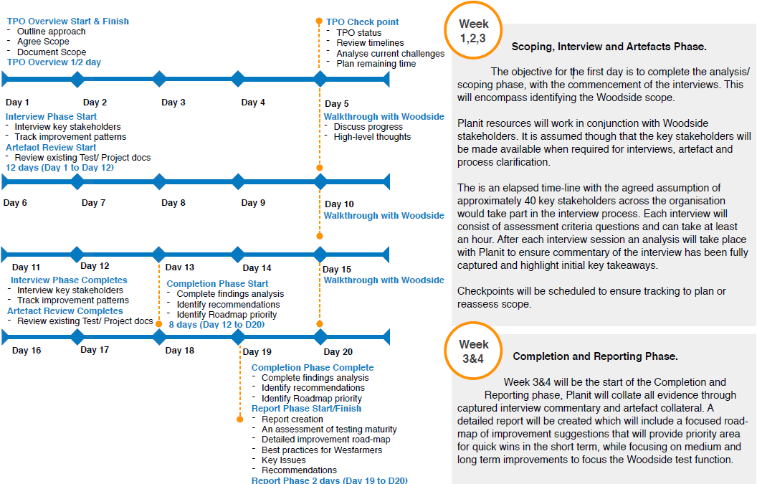
Schedule

Slide 47

Efficiency & Maturity Roadmap
Continuous Improvement – Defect Leakage rates and optimise
COST
Rollout strategy across ALM, standardise and Training
Low
Medium
Enterprise CoE
High
Test Case Design Practices
COMPLEXITTY
Low
Medium
High
Automated Testing Framework
Define and Implement Test Process, including Strategies and Plans
40
30
Efficiency gain (%)
20
10
© Planit Software Testing

Slide 48
Implementation Phases
Test Process
Optimisation
Tool Review
Implementation
Develop, Socialise and Implement
TPO
Tooling Review
Overall Test Process
Static testing
Asses Test Maturity
POC
Test Artefact Templates
IP/Test Guides
Identify Future State
Technical Fit
Test Planning Process (Risk / Scalability Matrix)
Environment management
Roadmap
Enterprise Suitability
Test Estimation Process / Techniques
Quality of inputs into testing
Estimates and Resources
ROI
Tools Strategy
Implementation Approach
Test Engagement Process
Enterprise Automation
Service Virtualisation POC
Test Conditions / Case / Regression Test Suite
Enterprise Performance
FIXED = $
FIXED = $
Test Case / Defect Management / Defect Triage / Reporting in ALM
Service Catalogue
15 - 20 days
15 – 20 days
Project Resources
$ T&M
Or Managed Service
Notes:
Develop, Socialise and Implement (Pilot Project)
Overall Test Process
Test artefact templates
Test Planning Process (risk / scalability matrix)
Test Estimation Process / Techniques
Test Engagement Process
Test Conditions/Test Case/Regression Test Suite
Test Case/Defect Management/Defect triage/Reporting in tool
Static testing
IP/Test Guides
Environment management
Quality of inputs into testing
Automation strategy/framework
Performance testing process/strategy

Slide 49
Business Benefits
Embrace a Quality Principle of having an external and independent party assessing the quality and outcome of the test process
Determine the efficacy and efficiency of the test process in practice
Identify the real cost of quality for better planning, estimates and costing of projects
Provide a framework to collect opinions and views from inside and outside of the organisation of ideas and a structured method towards improvement
Promote the “Shift-Left” quality paradigm to enable early engagement of testing activities in a development-oriented IT ecosystem. Quality built-in instead of tested-out.
Increase the quality of business applications in parallel to a continuous enrichment of customer satisfaction

Slide 50
Technical Benefits
Ability to identify areas where technology can introduce efficiency gains during the test process
Reduce environment and testing complexity through the implementation of technology supporting the test process
Harness the quality of Woodside products through automation
Reduce technical debt when going live

Slide 51
Summary
In order to know where you what to go you must first know where you are!

Slide 52
Testing Centre Of Excellence Overview

Slide 53
Overview
To provide context and key considerations around the journey towards a Testing Centre of Excellence and establishing the scale of the undertaking.
Business Drivers
What Is A TCoE
Major Goals
Benefits
Defect Costs
Key Strategies
Tools
Transition
Approach
Summary

Slide 54
Business Drivers for TCoE
Increased business demand
Time To Market
Effectiveness of testing
Inconsistent test processes
Test Centre Of Excellence
Improve Quality
Test time consumption
Reduce Reputational Risk
Test Environment Stability

Slide 55
View OF A Testing Centre Of Excellence
Building Valuable Customer Relationships
Transform the way of Operating
VISION
Developing Talent
Making Performance Matter
BENEFITS
Scalable
Repeatable
Reliable
Auditable
Efficient
TESTING CENTRE OF EXCELLENCE
KEY BUILDING BLOCKS
Processes
People
Infrastructure and Tools
Knowledge Management
KEY PERFORMANCE INDICATORS
Reduce Time-to-delivery/market
Improved Customer Satisfaction
Lower Testing Costs
Improved Testing Effectiveness
Compliance & Service
DIFFERENTIATORS & ACCELERATORS
Quality
Methods & Tools
Automation Testing
Performance Testing
Functional Testing
Strategic Enablers
Governance
Technology Competency Group
Sponsorship
IT Business Alignments

Slide 56
Major Goals of a TCoE
Repeatable
Enable without hampering
Empower, measure and govern
Transform organisational knowledge, skills and capabilities
Create accelerators
Enable tools and technology
Continuous improvement
Increase quality
Consistent test relationship
Reliable
Auditable
Efficient
Scalable

Slide 57
Benefits
Informed Risk Decisions
Defined Test Boundaries
Testing Cost Reduction
Aligned Testing Policy
Tools and Technology Efficiency
Continuous
Improvement
Test Best Practice
Increased Testing
Value
Improved Quality
Faster To Market
Defect Reduction
Centralised Test Function
Test Metrics
Optimised Test SLA’s

Slide 58
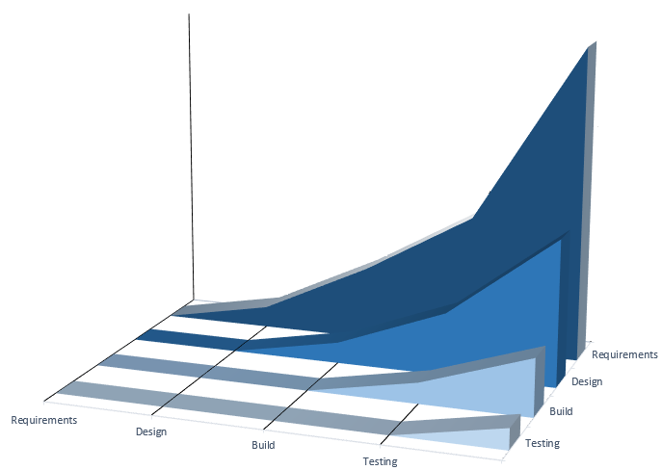
Cost of Defect Detection and Correction
Defect Cost to Correct
Defect Created Phase
Defect Detected Phase

Slide 59
Key Strategies
Integration of all departments
Integration of all departments
Rationalise technology
Rationalise technology
Market the TCoE concept
Testing Centre Of Excellence
Define common goals
Senior management involvement
Define common goals
Establish a champion
Develop clear vision
Establish a champion
Develop clear vision
Understand current Test State
Define Measurement of success
Think at enterprise level
Define Measurement of success
Think at enterprise level
Identify pilot
Identify pilot

Slide 60

A View Of A TCoE Phased Approach
Phase 1(TPO)
Phase 3 (Transition)
1.Understanding testing
landscape, define TCoE
implementation roadmap
2. Begin fundamental polices
For application testing
3.Define reporting
procedures
1.TCoE works as central source for
entire organisation
2. Gets more projects
under TCoE scope
Phase 2 (Pilot)
1.Initiate tactical projects
2. Start functions as a shared
service
3. Training
Phase 4 (Continuous Improvement)
1.TCoE takes complete ownership of QA
2. Functions as a test service provider
3. Offers testing resources, tools, methodologies,
governance and expertise for testing application
and cross-functional business processes
4.Inculdes test management
Offices, shared services teams
and domain-specific expertise
teams
5. Unit testing, integration testing,
Security, system testing
4.Define measurable quality
standards
5. Implement governance
process
6. Test planning, test case
deployment, defect management
Test automation, test case
management
4.Tool procurement,
setting up and test
environment setup
5. Test and automation
strategy

Slide 61
Workshop

Slide 62
Thoughts
Test Governance
How to your track governance/Quality gates
How do you track progress
What is your defect management progress
Are your test artefacts useful
What type of vendor quality SLA’s are in place.
Aspirations
What does success look like
Does your business want change
When do you require change
Why do you think you need it
Ownership and Risk
Who owns the test function
How do you evaluate project risk
What's the scale of your delivery portfolio
Who owns the test estimate
What level of test independence do you have
Perception of Test
What works well
What needs improved
How do you think you will achieve success
Current Test State
What is your test policy and framework
What is your test methodology
What are your test phases
When does test get engaged
Is testing a career in Woodside
What % per project test cost
How Do You Measure Success
How does testing get involved with risk decisions
What levels of traceability from requirement through to test
What scale of defects are you finding in live
What are your test KPI and reporting standards
Tools and Environments
What test tools are used
How is your test environment setup
What is your configuration management approach
How do you manage version control

Slide 63
QUESTIONS

Slide 64
Next Steps…
Market Leaders
Pioneers in Training
Accredited Consultants
Testing Specialists
Thought Leaders

Slide 65
Contact Us
Andrew White Director Of Operations Perth
Main: +61 8 6109 3800 Dir: +61 8 6109 3812 Mob: +61 404 001 055 Email: awhite@planittesting.com Web: www.planittesting.com

